Slide 1
Pack modeling with liionpack
Valentin Sulzer

Slide 2
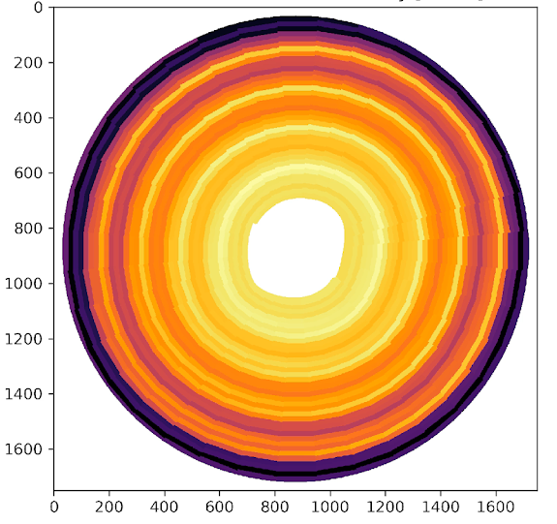
Introduction
Understanding, optimizing, and managing large packs is crucial to achieve battery cost and efficiency targets
Liionpack: A Python package for simulating packs of batteries with PyBaMM
Open-source at https://github.com/pybamm-team/liionpack
Works with any PyBaMM model
Different parameter sets
Thermal models
Degradation models
…
Inspired by Tom Tranter’s work on jellyroll modeling

Slide 3
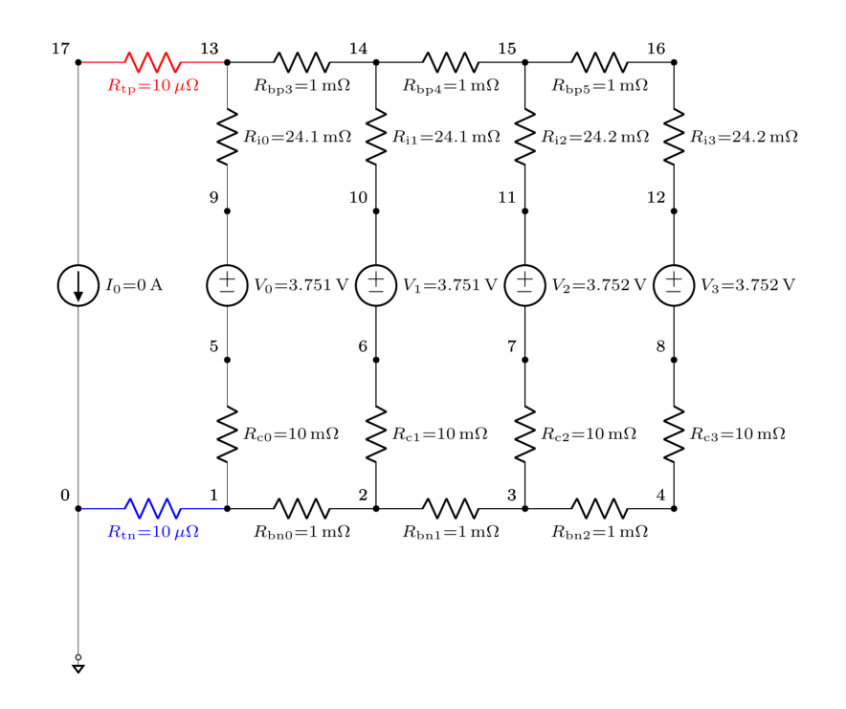
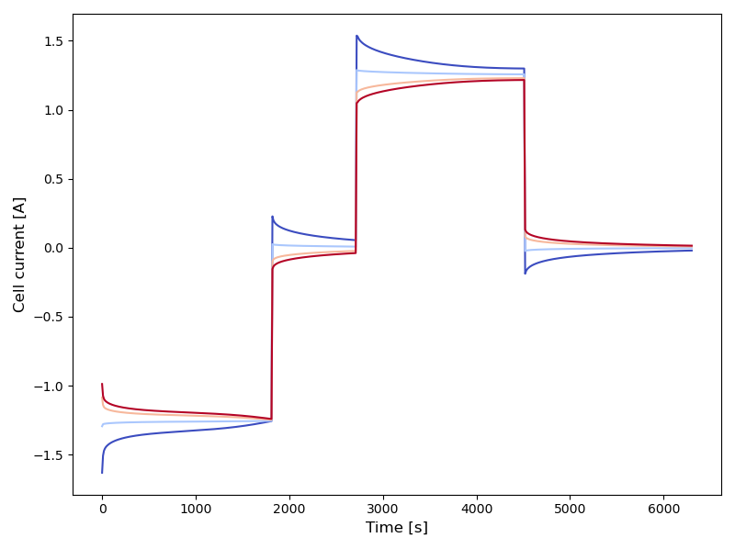
Basic example
Simulated current through each cell
(CC charge / rest / CC discharge / rest)
Four cells in parallel
1 cell
(PyBaMM)

Slide 4
How does it work?

Slide 5
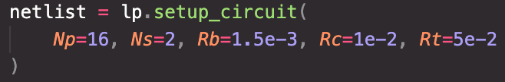
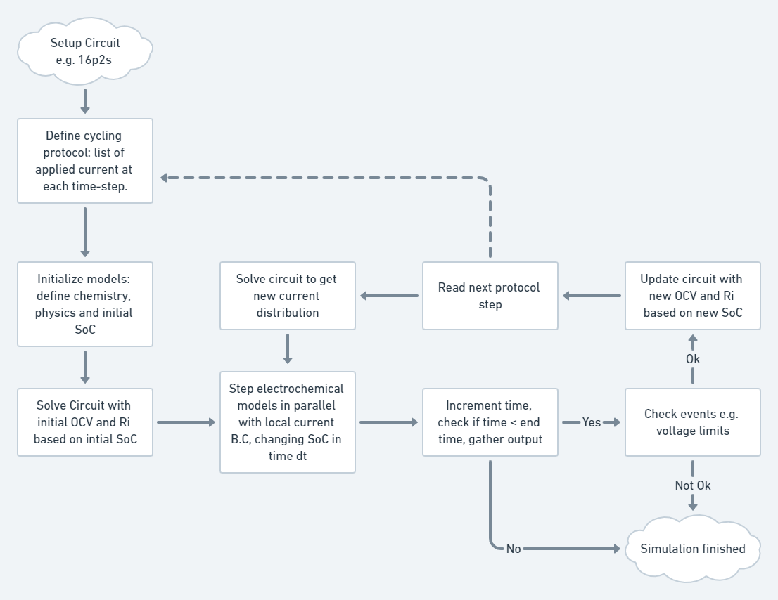
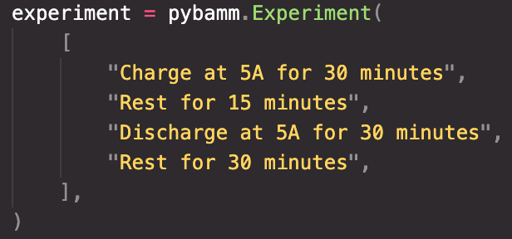
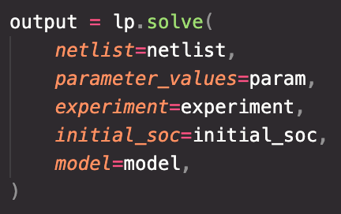
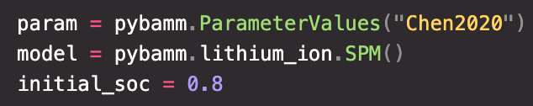
Solution overview

Slide 6
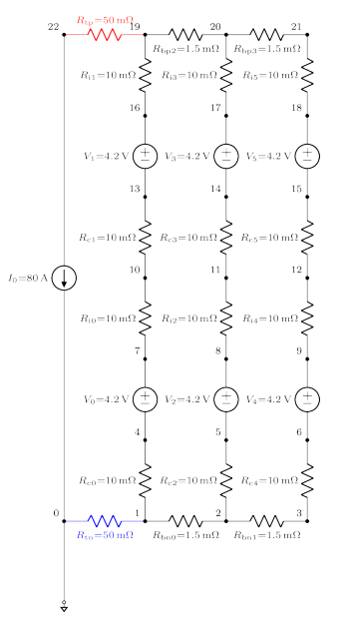
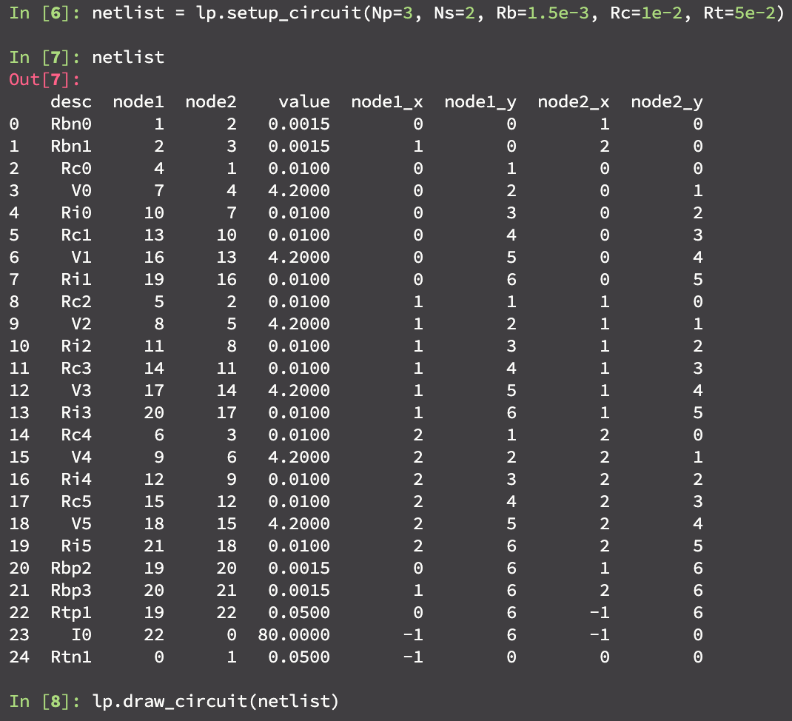
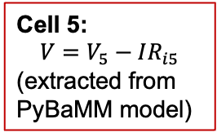
Circuit representation
Cell 5:
$$V=V_{5}−IR_{i5}$$
(extracted from
PyBaMM model)

Slide 7
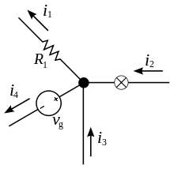
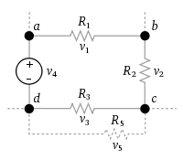
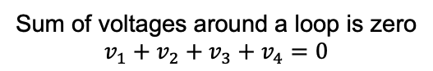
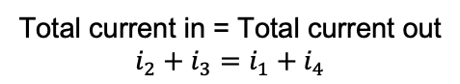
Modified Nodal Analysis
“Kirchhoff’s circuit laws for algorithms”
Modified Nodal Analysis: write these in the form Ax=b (solve for x)
Kirchhoff’s current law
Kirchhoff’s voltage law
Total current in = Total current out
$$i_{2}+i_{3}=i_{1}+i_{4}$$
Sum of voltages around a loop is zero
$$v_{1}+v_{2}+v_{3}+v_{4}=0$$
https://en.wikipedia.org/wiki/Kirchhoff%27s_circuit_laws

Slide 8
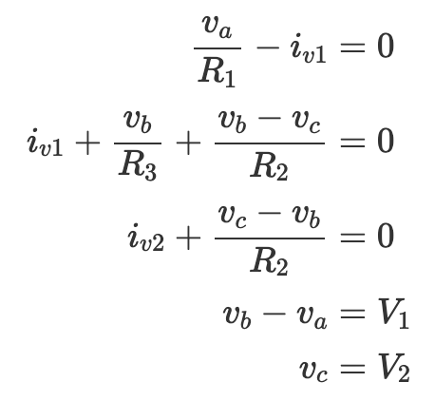
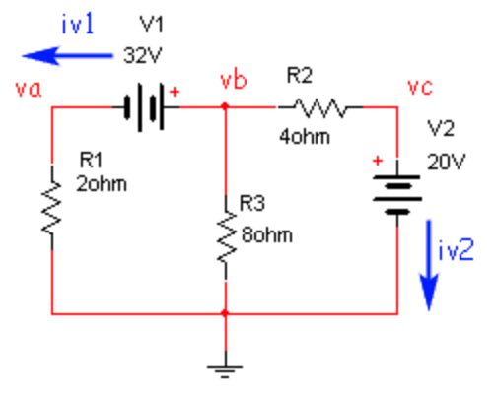
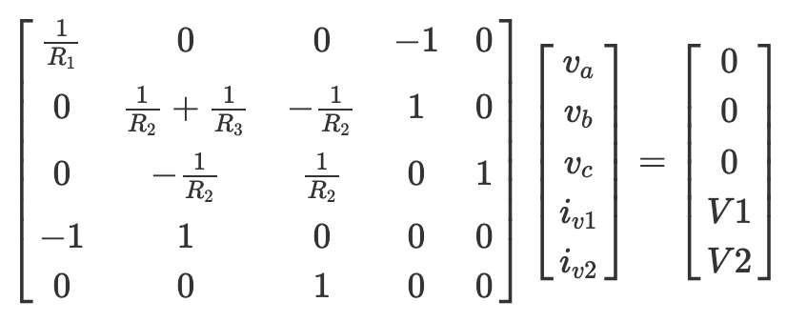
Modified Nodal Analysis
KC1
Example circuit
KC2
KC2
KC3
KC3
KV1
KV2
KC1
KV1
KV2
0 V
A
x
b
https://lpsa.swarthmore.edu/Systems/Electrical/mna/MNA2.html

Slide 9
Iterative solution
MNA (Ax=b)
PyBaMM solver step

Slide 10
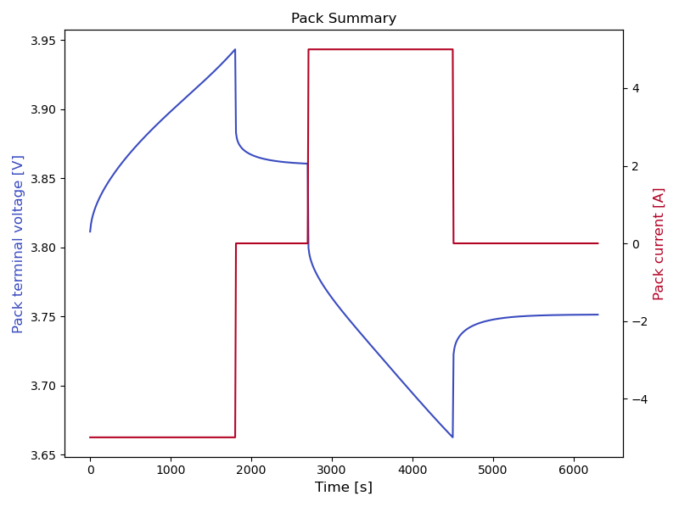
Results (4p1s)

Slide 11
Advanced Features

Slide 12
Thermal model
Note: thermal conduction between cells not yet implemented

Slide 13
Different initial SOCs

Slide 14
Drive cycles

Slide 15
Visulazing larger packs
Voltage distribution in a 100p50s pack

Slide 16
Degradation model
4 cells in parallel, different SEI rate constants

Slide 17
Terminal locations
left
right
left-right
middle

Slide 18
Terminal locations
~10% variation based on terminal location

Slide 19
Multiprocessing
Use dask or ray for solving PyBaMM cell models in parallel on clusters
32 parallel, 20 series (~1.6 kWh simulated)
400 parallel, 125 series (~250 kWh simulated)
MacBook Pro laptop
CADES cloud 80 vCPU

Slide 20
Summary
Liionpack allows fast pack simulations with a simple interface
PyBaMM back-end enables understanding how advanced models of individual cells interact in a pack
Future directions
Different pack topologies
Thermal transmission between cells
More efficient numerical methods (and/or reduced-order models)
Still in beta, open to new contributors!

Slide 21








Acknowledgements
Tom Tranter,
Robert Timms,
Ferran Brosa-Planella,
Gavin Wiggins,
Srikanth Allu,
Vikrant Karra,
Priyanshu Agarwal, Saransh Chopra,
Dan Brett,
Paul Shearing

